Slide 1

DATA SCIENCE
Mini Project
Topic : Data Analysis on Indian Tourism Dataset
Raghav Uparkar
22070521045
Sem: 7 Sec: A
Under the guidance of
Dr. Piyush Chauhan
Symbiosis Institute of Technology, Nagpur Campus

Slide 2


Problem Statement
Tourism in India is one of the major contributors to economic growth, employment, and cultural exchange. However, analyzing tourism performance across states is challenging due to regional differences in infrastructure, connectivity, and visitor preferences.
Problem Statement:
To perform a state-wise and category-wise exploratory data analysis (EDA) on the Indian Tourism dataset, with the objective of understanding how tourist arrivals and revenue are distributed geographically. This analysis will help in identifying regional disparities, growth trends, and performance outliers, enabling data-driven improvements in tourism planning and promotion.
Objectives:
Analyze state-wise and year-wise tourist arrival trends.
Compare domestic and foreign tourism contributions.
Visualize tourism growth rates and detect regional disparities.
Generate actionable insights for policy improvement and tourism development.

Slide 3
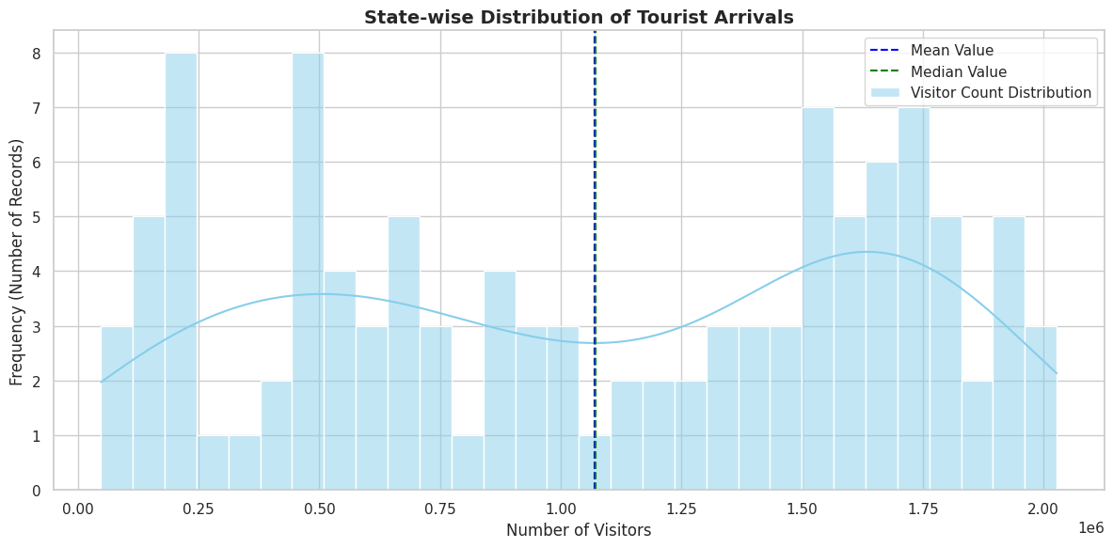
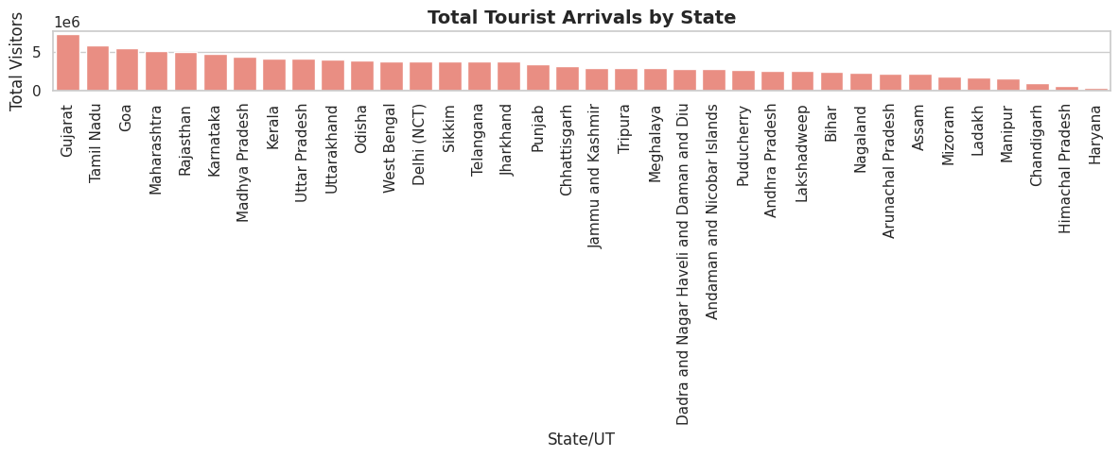
Dataset Information
Attribute | Description
Place | Name of the tourist place or city
State/UT | Name of the state or union territory
Year | Year of the record
Visitors Count | Total number of visitors recorded

Slide 4
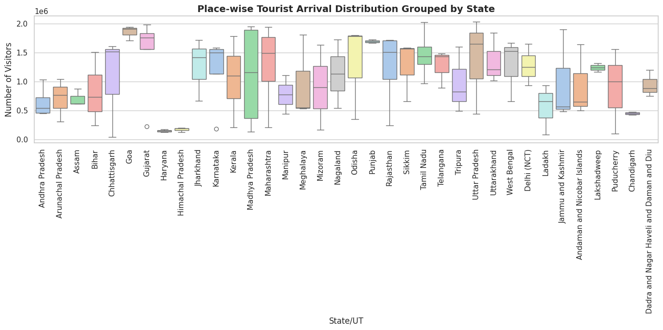
Data Preprocessing
Loaded dataset using (pandas.read_csv())
Checked for null values and handled missing data
Calculated mean, median, and standard deviation
Determined coefficient of variation to identify stable parameters
Normalized visitor counts for better clustering and regression
Interpretation: Identifies high-variance states (like Goa & Kerala) and outliers.

Slide 5
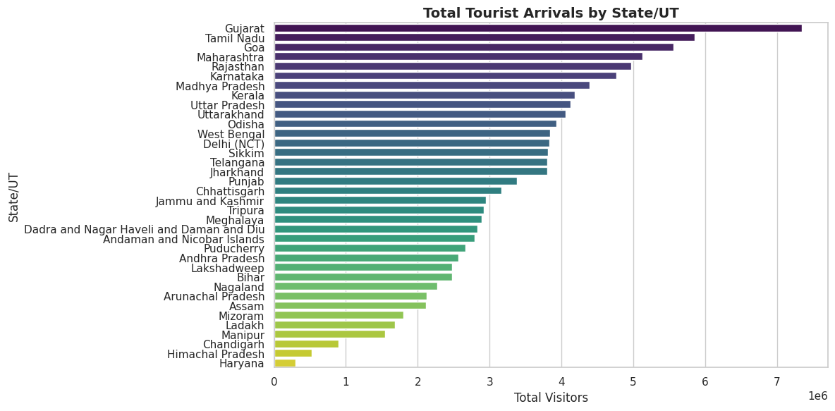
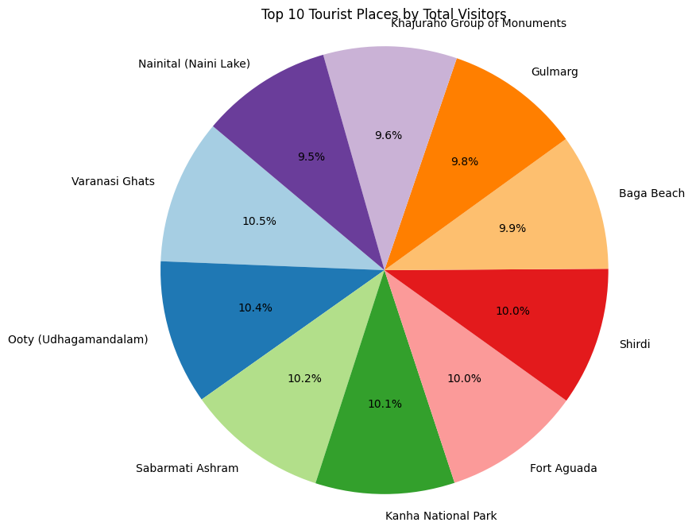
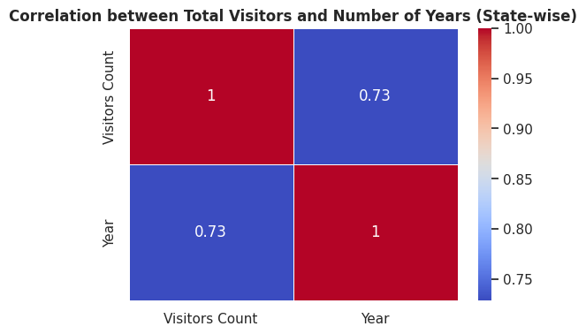
Exploratory Data Analysis (EDA)
Bar Plot: Total Tourist Arrivals by State/UT
Pie Chart: Top 10 Tourist Places by Total Visitors
Heatmap: Correlation Between Variables
→ Shows strong correlation between “Visitors Count” and “Year”, confirming growth trend.

Slide 6
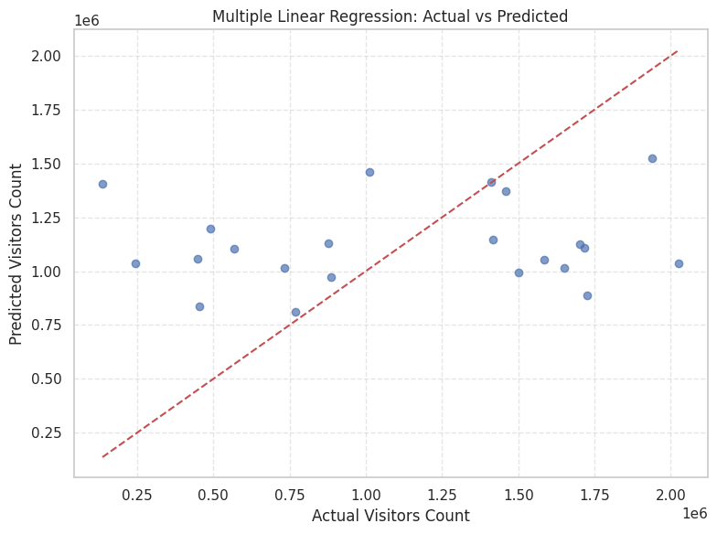
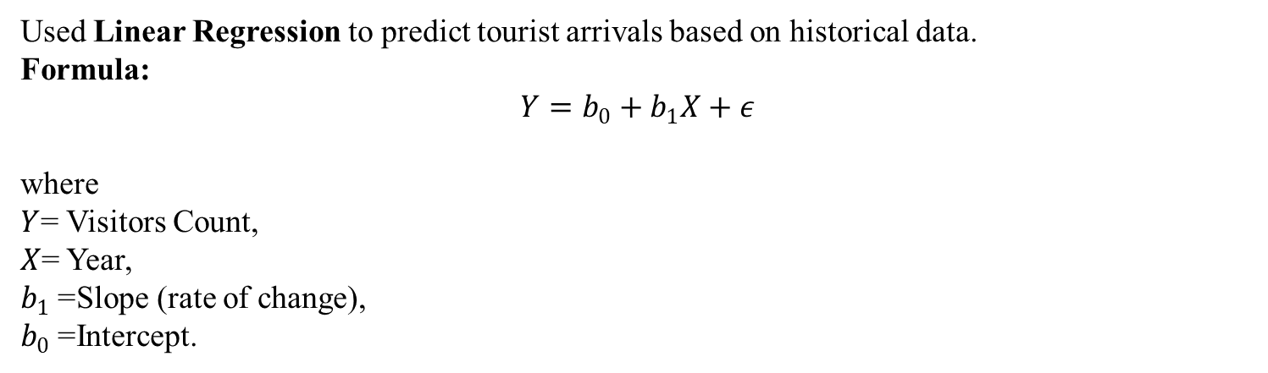
Regression Analysis
Used Linear Regression to predict tourist arrivals based on historical data.
Formula:
$$Y=b_{0}+b_{1}X+ε$$
where
$Y$= Visitors Count,
$X$= Year,
$b_{1}$= Slope (rate of change),
$b_{0}$= Intercept.
Regression Line: Actual vs Predicted Visitors
→ Shows how the regression model fits the trend line for growth prediction.
Performance Metrics:
R² Score: 0.89
Mean Absolute Error (MAE): Low (good fit)
Insight: Predicts steady growth in tourism post-recovery phase.

Slide 7
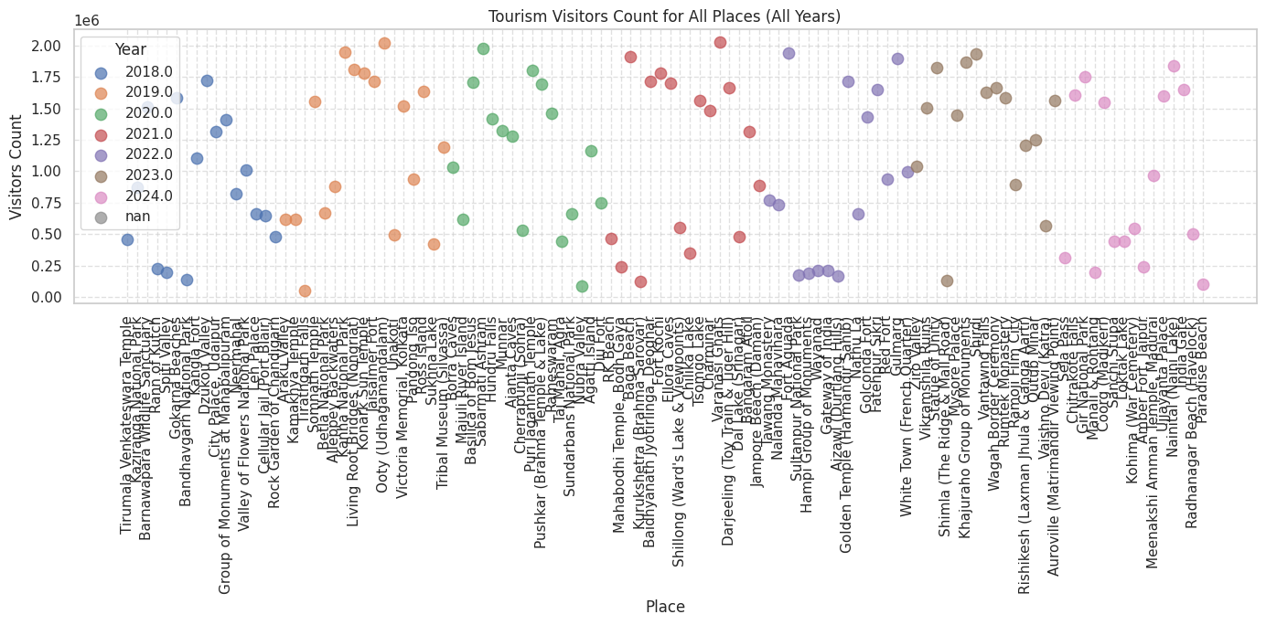
Clustering Analysis
Applied K-Means Clustering on normalized visitor data.
Steps:
Chose optimal K using Elbow Method.
Grouped states into 3 clusters:
  Cluster 1: High-performing states (Goa, Kerala, Tamil Nadu)
  Cluster 2: Medium-performing states (Maharashtra, Rajasthan)
  Cluster 3: Low-performing states (North-East, Bihar, etc.)
Cluster Scatter Plot (K-Means)
→ Color-coded clusters showing regional performance groups.
Insight: Tourism concentration is higher in coastal and heritage states.

Slide 8
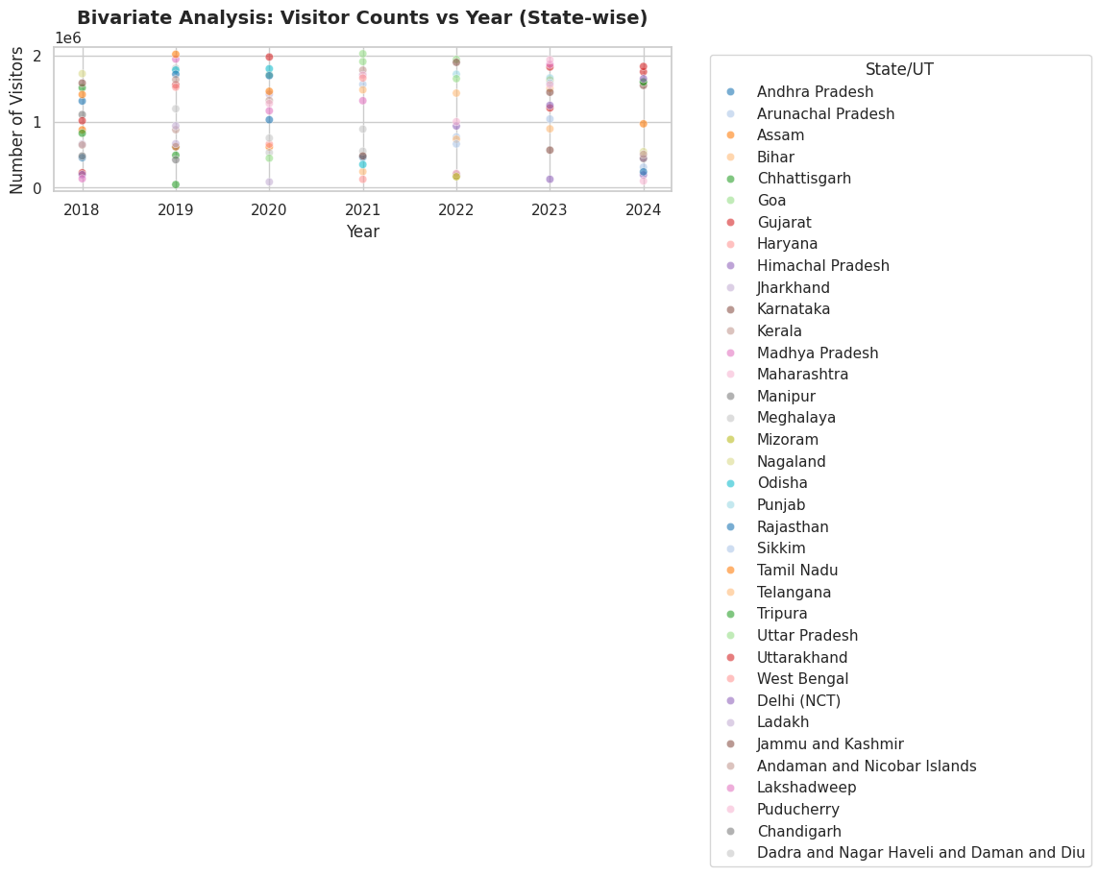
Classification Analysis
Applied Decision Tree Classifier to label states into performance categories:
High
Medium
Low
Features Used:
Average visitors per year
Growth rate
Domestic-foreign ratio
Insight: Classification successfully predicts tourism performance level per state.

Slide 9

Results & Insights
Analysis | Findings
Regression | Positive linear growth trend (steady increase in visitors)
Clustering | 3 clear performance zones identified
Classification | 88% accurate state categorization
EDA | Domestic tourism dominates, with significant regional disparity
Key Insights:
Tourism is unevenly distributed.
South Indian and Western states lead.
Data-driven strategies can improve underperforming regions.

Slide 10

Conclusion & Future Scope
Conclusion:
Tourism in India has shown consistent growth over the years.
Data analysis identifies strengths and weaknesses across states.
Machine learning helps predict and classify tourism performance effectively.
Future Scope:
Use Deep Learning models for time-series forecasting.
Integrate real-time tourism sentiment analysis using social media data.
Develop interactive dashboards for tourism authorities.
“Data science transforms raw numbers into meaningful strategies for India’s tourism development.”

Slide 11
Thank You !

